Slide 1
Interactions between Storage Company’s Stocks
IST 652 Final Project
by Emilio Ramos Monzalvo

Slide 2
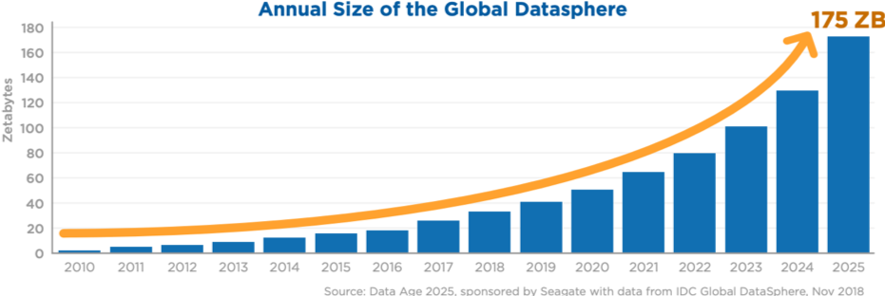
Data Collection Growth
Demands for data storage are growing exponentially.
Data Storage Device Manufacturers have been capitalizing from this trend.
There is only a handful of companies with significant market share, so can we understand their interactions/dependencies?
* One zettabyte is equal to one sextillion bytes or 10²¹

Slide 3
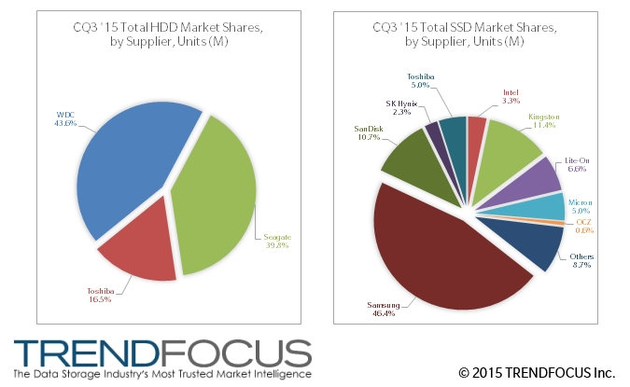
Computer Storage Market Share
There are two main types of storage devices that live on our computers: Solid State Drives (SSD) and Hard Disk Drives (HDD)
Since the beginning of 2010, the storage device market has been dominated by the same companies.

Slide 4
Finding and Selecting the Dataset
Selected Storage Companies:
Only top 7 Companies by market share were selected.
Yahoo Finance offers a simple interface to pull the data in python using the ‘yahoofinancials’ package.
In order to avoid external factors affecting the stock market, the time frame range from 2010 to the end of 2019.
Company | Storage Tech Type | Stock Identifier | Stock Market Index
Western Digital | SSD and HDD | WDC | NASDAQ
Seagate | HDD | STX | NASDAQ
Toshiba | HDD | TOSYY | OTC Markets
Intel | SSD | INTC | NASDAQ
Samsung | SSD | 005930.KS | KRW
Micron | SSD | MU | NASDAQ
Kingston | SSD | KINS | NASDAQ
* Two Major Stock Market Crashes: 2008 Housing Market Crash and 2020 COVID Market Crash

Slide 5
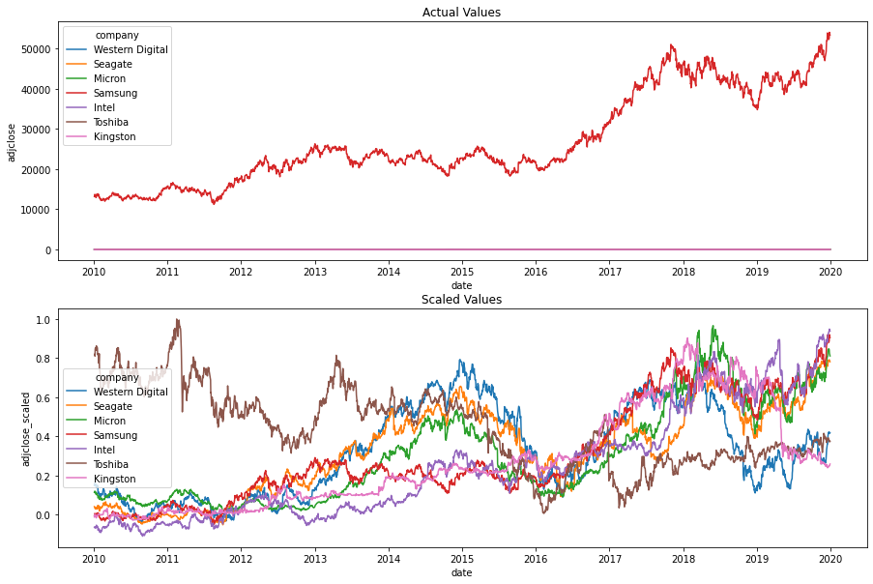
Exploring the Dataset
Since there is more than one foreign company in the dataset, the price columns can all be passed to USD.
This still does not help us compare each stock to each other as the USD average ranges from $2.25 to $114.
Therefore, we scale the price columns using a Min Max Scaler per stock.
Column | Meaning
High | Highest stock price in time interval unit.
Low | Lowest stock price in time interval unit.
Open | Starting stock price in time interval unit.
Close | Final stock price in time interval unit.
Volume | Number of trades in time interval unit.
Adjusted Close | Close stock price adjusted by accounting actions by the company.
Date | Starting date of interval unit.

Slide 6
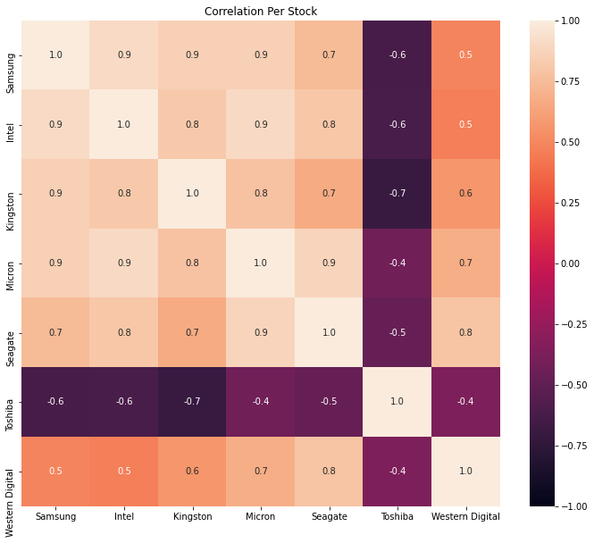
Comparing Companies Overall Trends
Important Findings:
Toshiba has a weak negative correlation with all the other stocks. Toshiba has been in a consistent decline unlike the rest of the companies.
Toshiba should be excluded from the rest of the analysis.
Western Digital has a weak correlation to most other companies except Seagate which is its main competitor in HDDs.
WDC’s week correlation can be attributed to its acquisition of SanDisk, an SSD giant, in 2016.

Slide 7
Conclusion and Next Steps
Conclusion:
Most storage company’s stock price shows a strong correlation to each other.
Toshiba’s stock price is not comparable to the rest.
Western Digital’s stock price shows the weakest correlation to most companies except Seagate.
Next Steps:
Predictive Analysis: Can we predict stock changes on one company based on the rest?
Can we not only predict a positive or negative change, but can we also predict the percentage increase/decrease?
The ‘Volume’ of the stock is also an important variable that should not be overlooked.
Volume or amount of stock traded is known to be a strong factor to the company's success.

Slide 8
Questions?

